Slide 1
Forecasting Inflation Rate using Time Series - India
Mentor:
Neha Ramchandani
NAME:
Arijit Sarkar
Nikhil Rajurkar
Yashaswini Raju
Gowtham M

Slide 2
Content:
Introduction
Objective
Project Flow

Slide 3
Introduction:
Inflation is commonly understood as a situation of substantial and general increase in the level of prices of goods and services in an economy and a consequent fall in the value of money over a period of time.
When the general price level rises value of money falls and as such each unit of currency buys fewer goods and services.
Consequently inflation reflects a reduction in the purchasing power per unit of money.
A chief measure of price inflation is the inflation rate which expresses percentage change in a general price index ( normally the consumer price index ) over time..

Slide 4
Objective:
The Goal of the project is to forecast the inflation rate for the national or global economy to develop business strategies accordingly.

Slide 5
Project Flow:
Preparing the Data
Exploratory Data Analysis
Model Building
Evaluation
Model Deployment

Slide 6
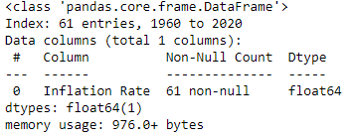
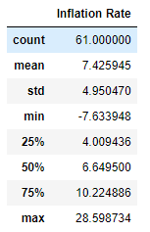
Data Preparation:
The Datasets for the project is obtained from the International Monetary Fund.
The IMF portal provides access to the historical data and we have gathered the data from 1960 to 2020.

Slide 7
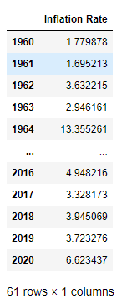
Data Preparation:
The Dataset contains Inflation rate year-wise from 1960 to 2020, i.e 61 Rows and 1 columns and none of the column have null-values.
All the values in the Dataset are of Float64 type.
The Dataset Contains Few Outliers. However the Presence of Outliers has been found not affecting the Mean. Hence the Outliers have been retained.

Slide 8
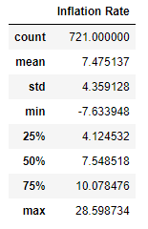
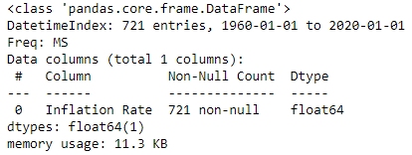
Data Preparation:
Here we have upsampled the data from year to month using linear interpolation method. Now the data contains 721 records.

Slide 9
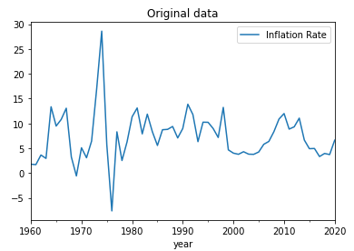
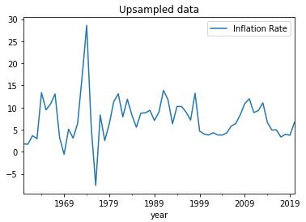
EDA:
Line plot of original data vs upsampled data

Slide 10
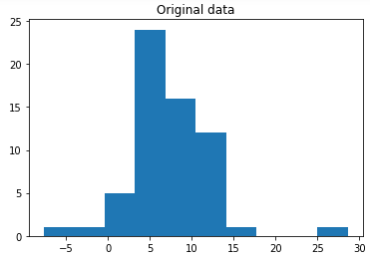
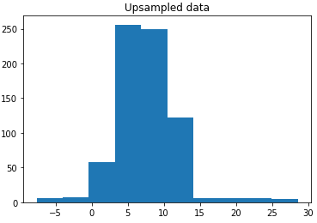
EDA:
Histogram of original data vs upsampled data

Slide 11
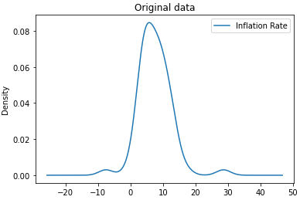
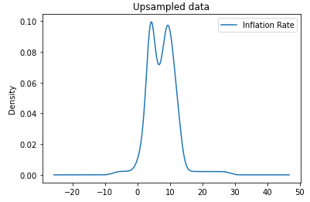
EDA:
Density plot of original data vs upsampled data

Slide 12
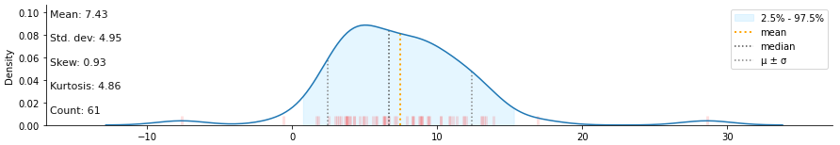
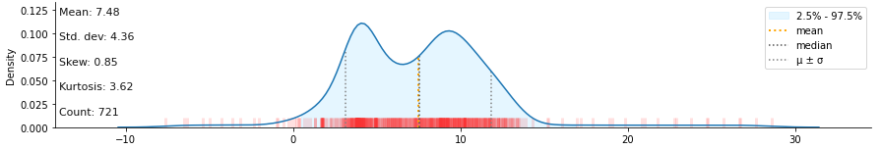
EDA:
Distribution plot of original data vs upsampled data

Slide 13
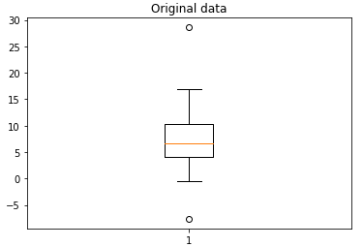
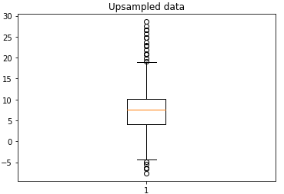
EDA:
Box plot of original data vs upsampled data

Slide 14
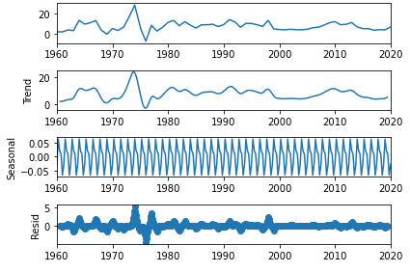
EDA:
Time series decomposition plot

Slide 15
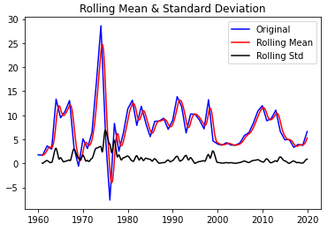
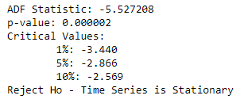
EDA:
Here stationarity is checked using rolling statistics and Augmented Dickey-Fuller (ADF) test.

Slide 16
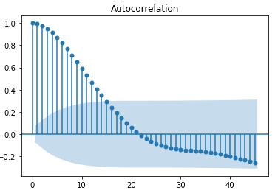
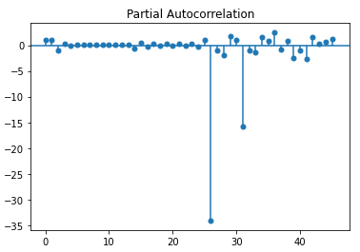
EDA:
Auto-Correlation Function (ACF) and Partial Auto-Correlation Function (PACF) Plot

Slide 17
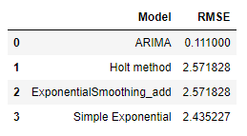
Model Building:
Here the 721 records are split into 621 training records and 100 test records.
Following models are tested.
Halt method
Exponential method
Simple Exponential method
ARIMA model
After the comparison of all these model, ARIMA model is considered for implementation because of the less RMSE value.

Slide 18
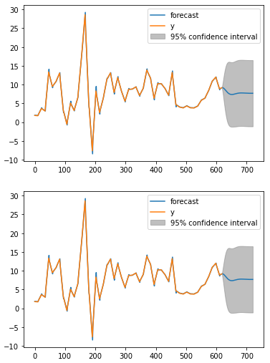
Model Building:
For ARIMA model, order is considered to be (2, 0, 1) and RMSE is 0.111
Error on test data is 2.8422
Figure shows the train and test data combined together.

Slide 19
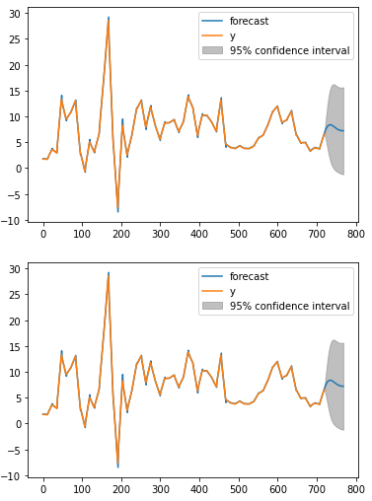
Model Building:
Figure shows the predicted graph for next 48 months

Slide 20
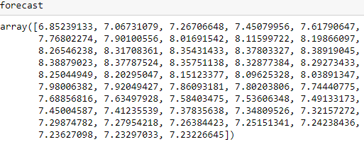
Model Building:
Forecasted value for next 48 months.

Slide 21
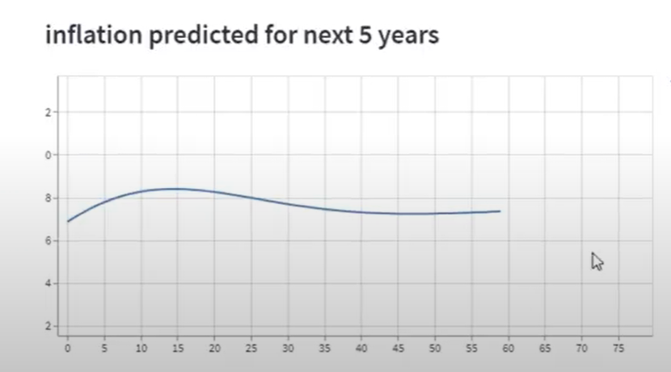
Deployment using sreamlit:

Slide 22
THANK YOU !

